Slide 1
What are some ways to deal with stress?
By: Ansel de Jong

Slide 2
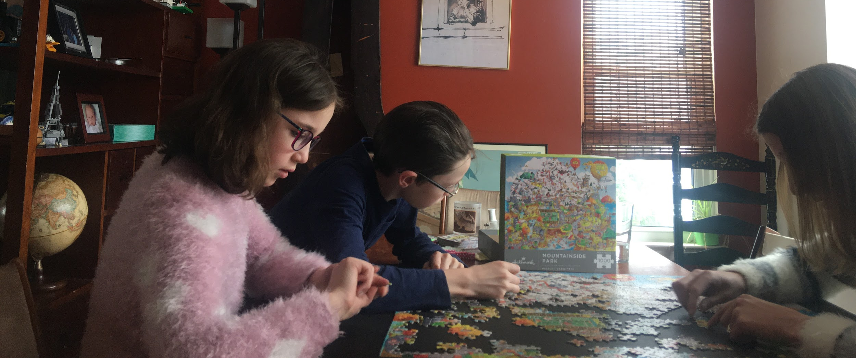
Do a puzzle
There’s something satisfying about putting each piece into its place on the puzzle, and it’s that that I really like about puzzles.

Slide 3
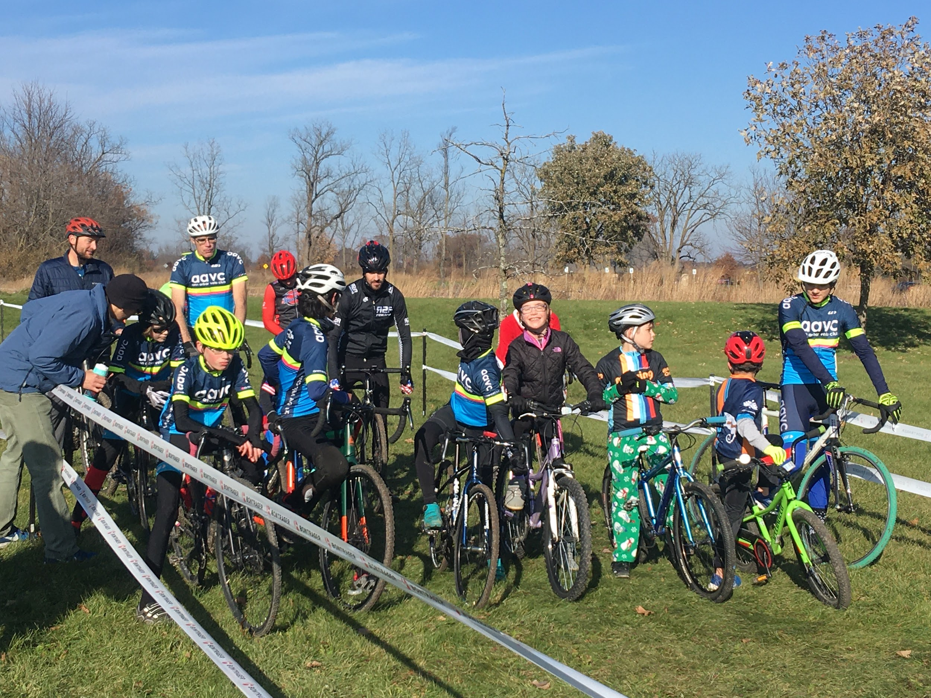
Ride a Bicycle
I love riding a bicycle for many reasons, but one of the best is the feeling of the tires against the asphalt. It’s a feeling that lets me get away from everything else.

Slide 4
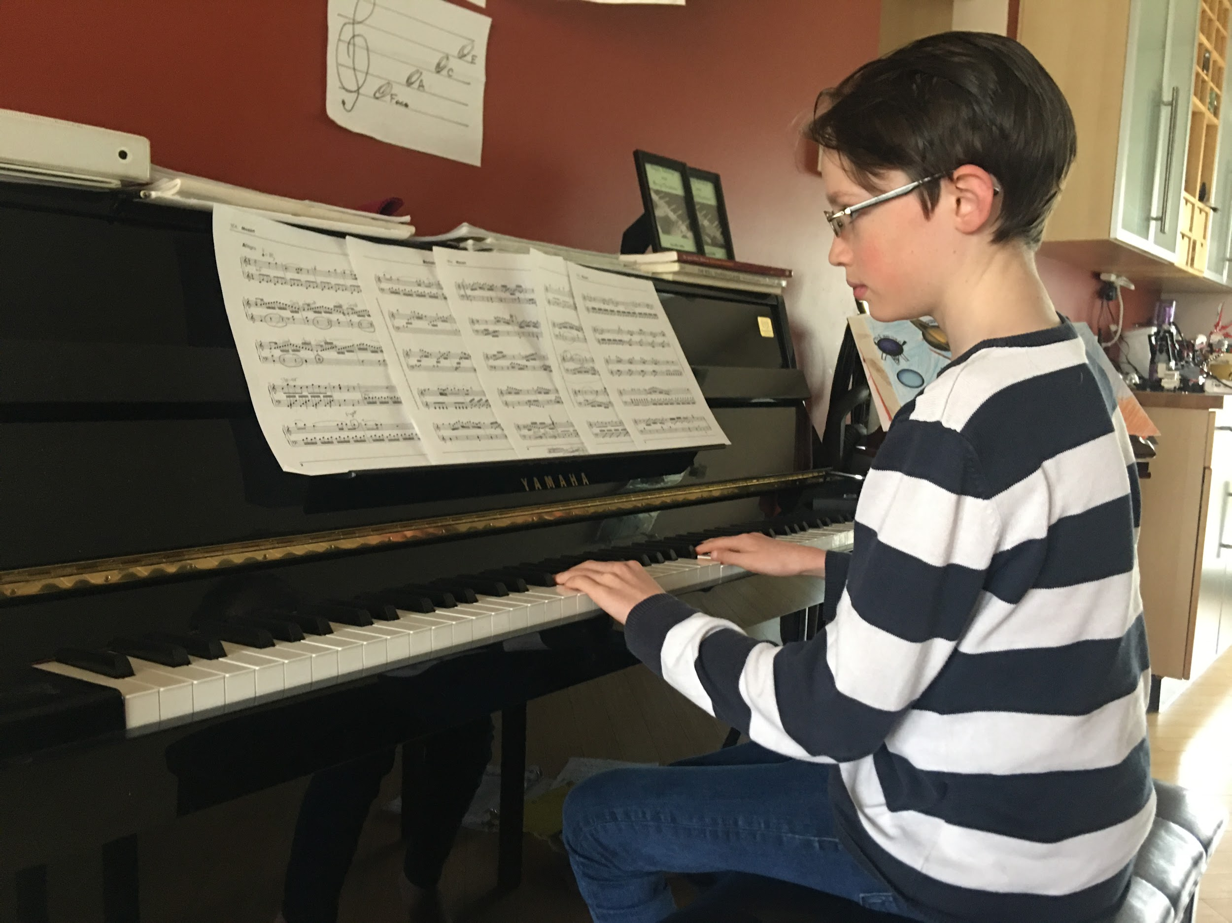
Play an Instrument
When playing a musical instrument, it makes me feel like I’m one with the piano. It a nice sensation that really helps to take my mind of things.

Slide 5
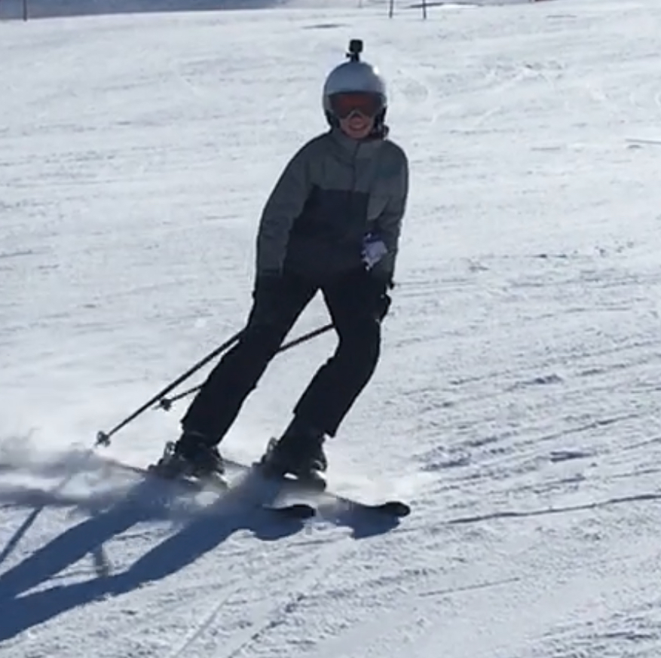
Go Skiing/Snowboarding
Skiing isn’t possible right now, but when there is snow, it is a lot of fun. I really like the feeling or making turns on the sharp edges of my skis, especially at high speeds. It really is exhilarating and stress relieving.

Slide 6
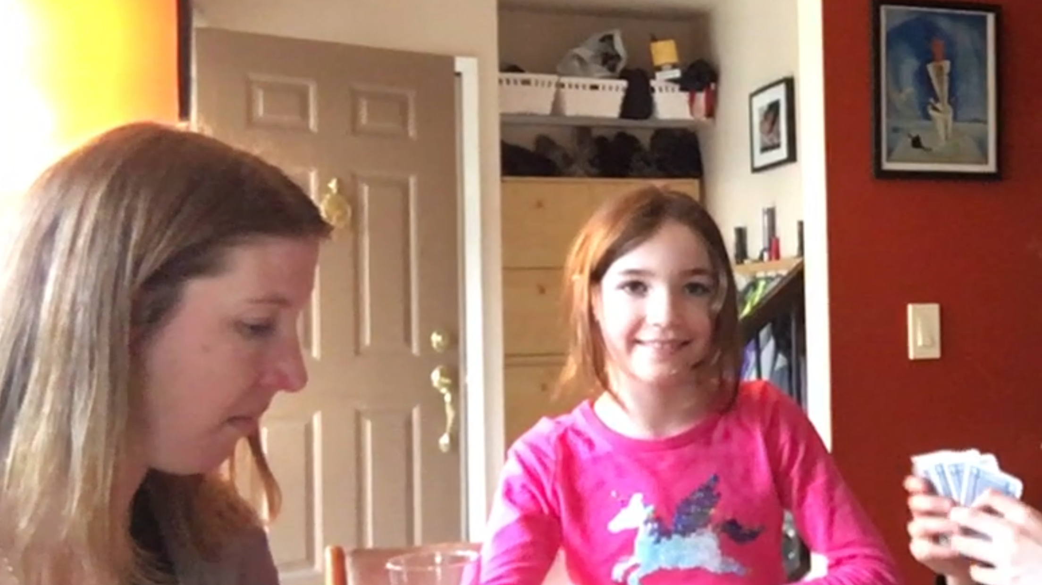
Play a game
Playing a game can be relaxing, and enjoyable. When I play a game, it’s nice to take a break from everything else that’s going on/stressing me out, as well as just spending time with family.

Slide 7
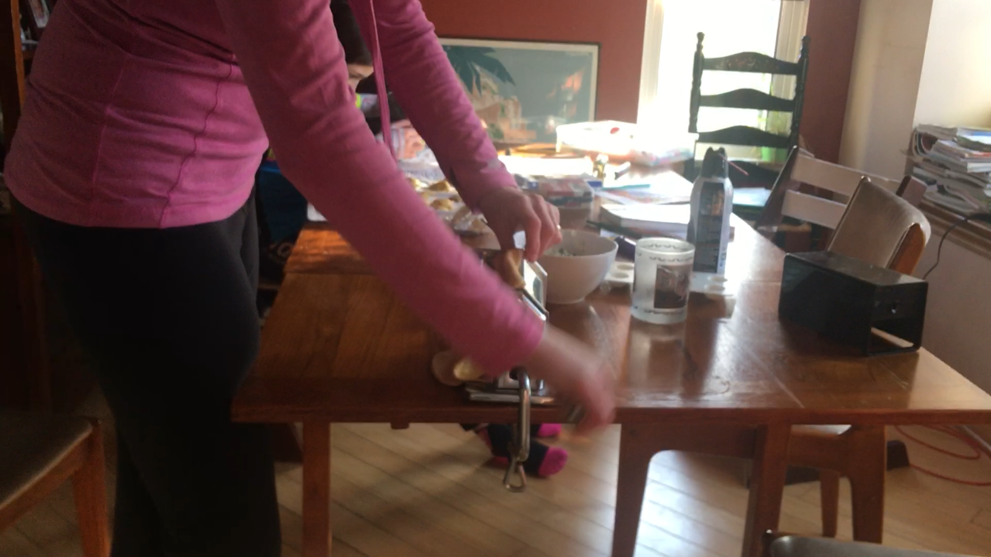
Cook or bake
Cooking or baking can be very helpful when one is stressed out. Pasta making is particularly fun due to the feeling or cranking the crank and forcing the sheet of homemade pasta thinner and thinner.

Slide 8
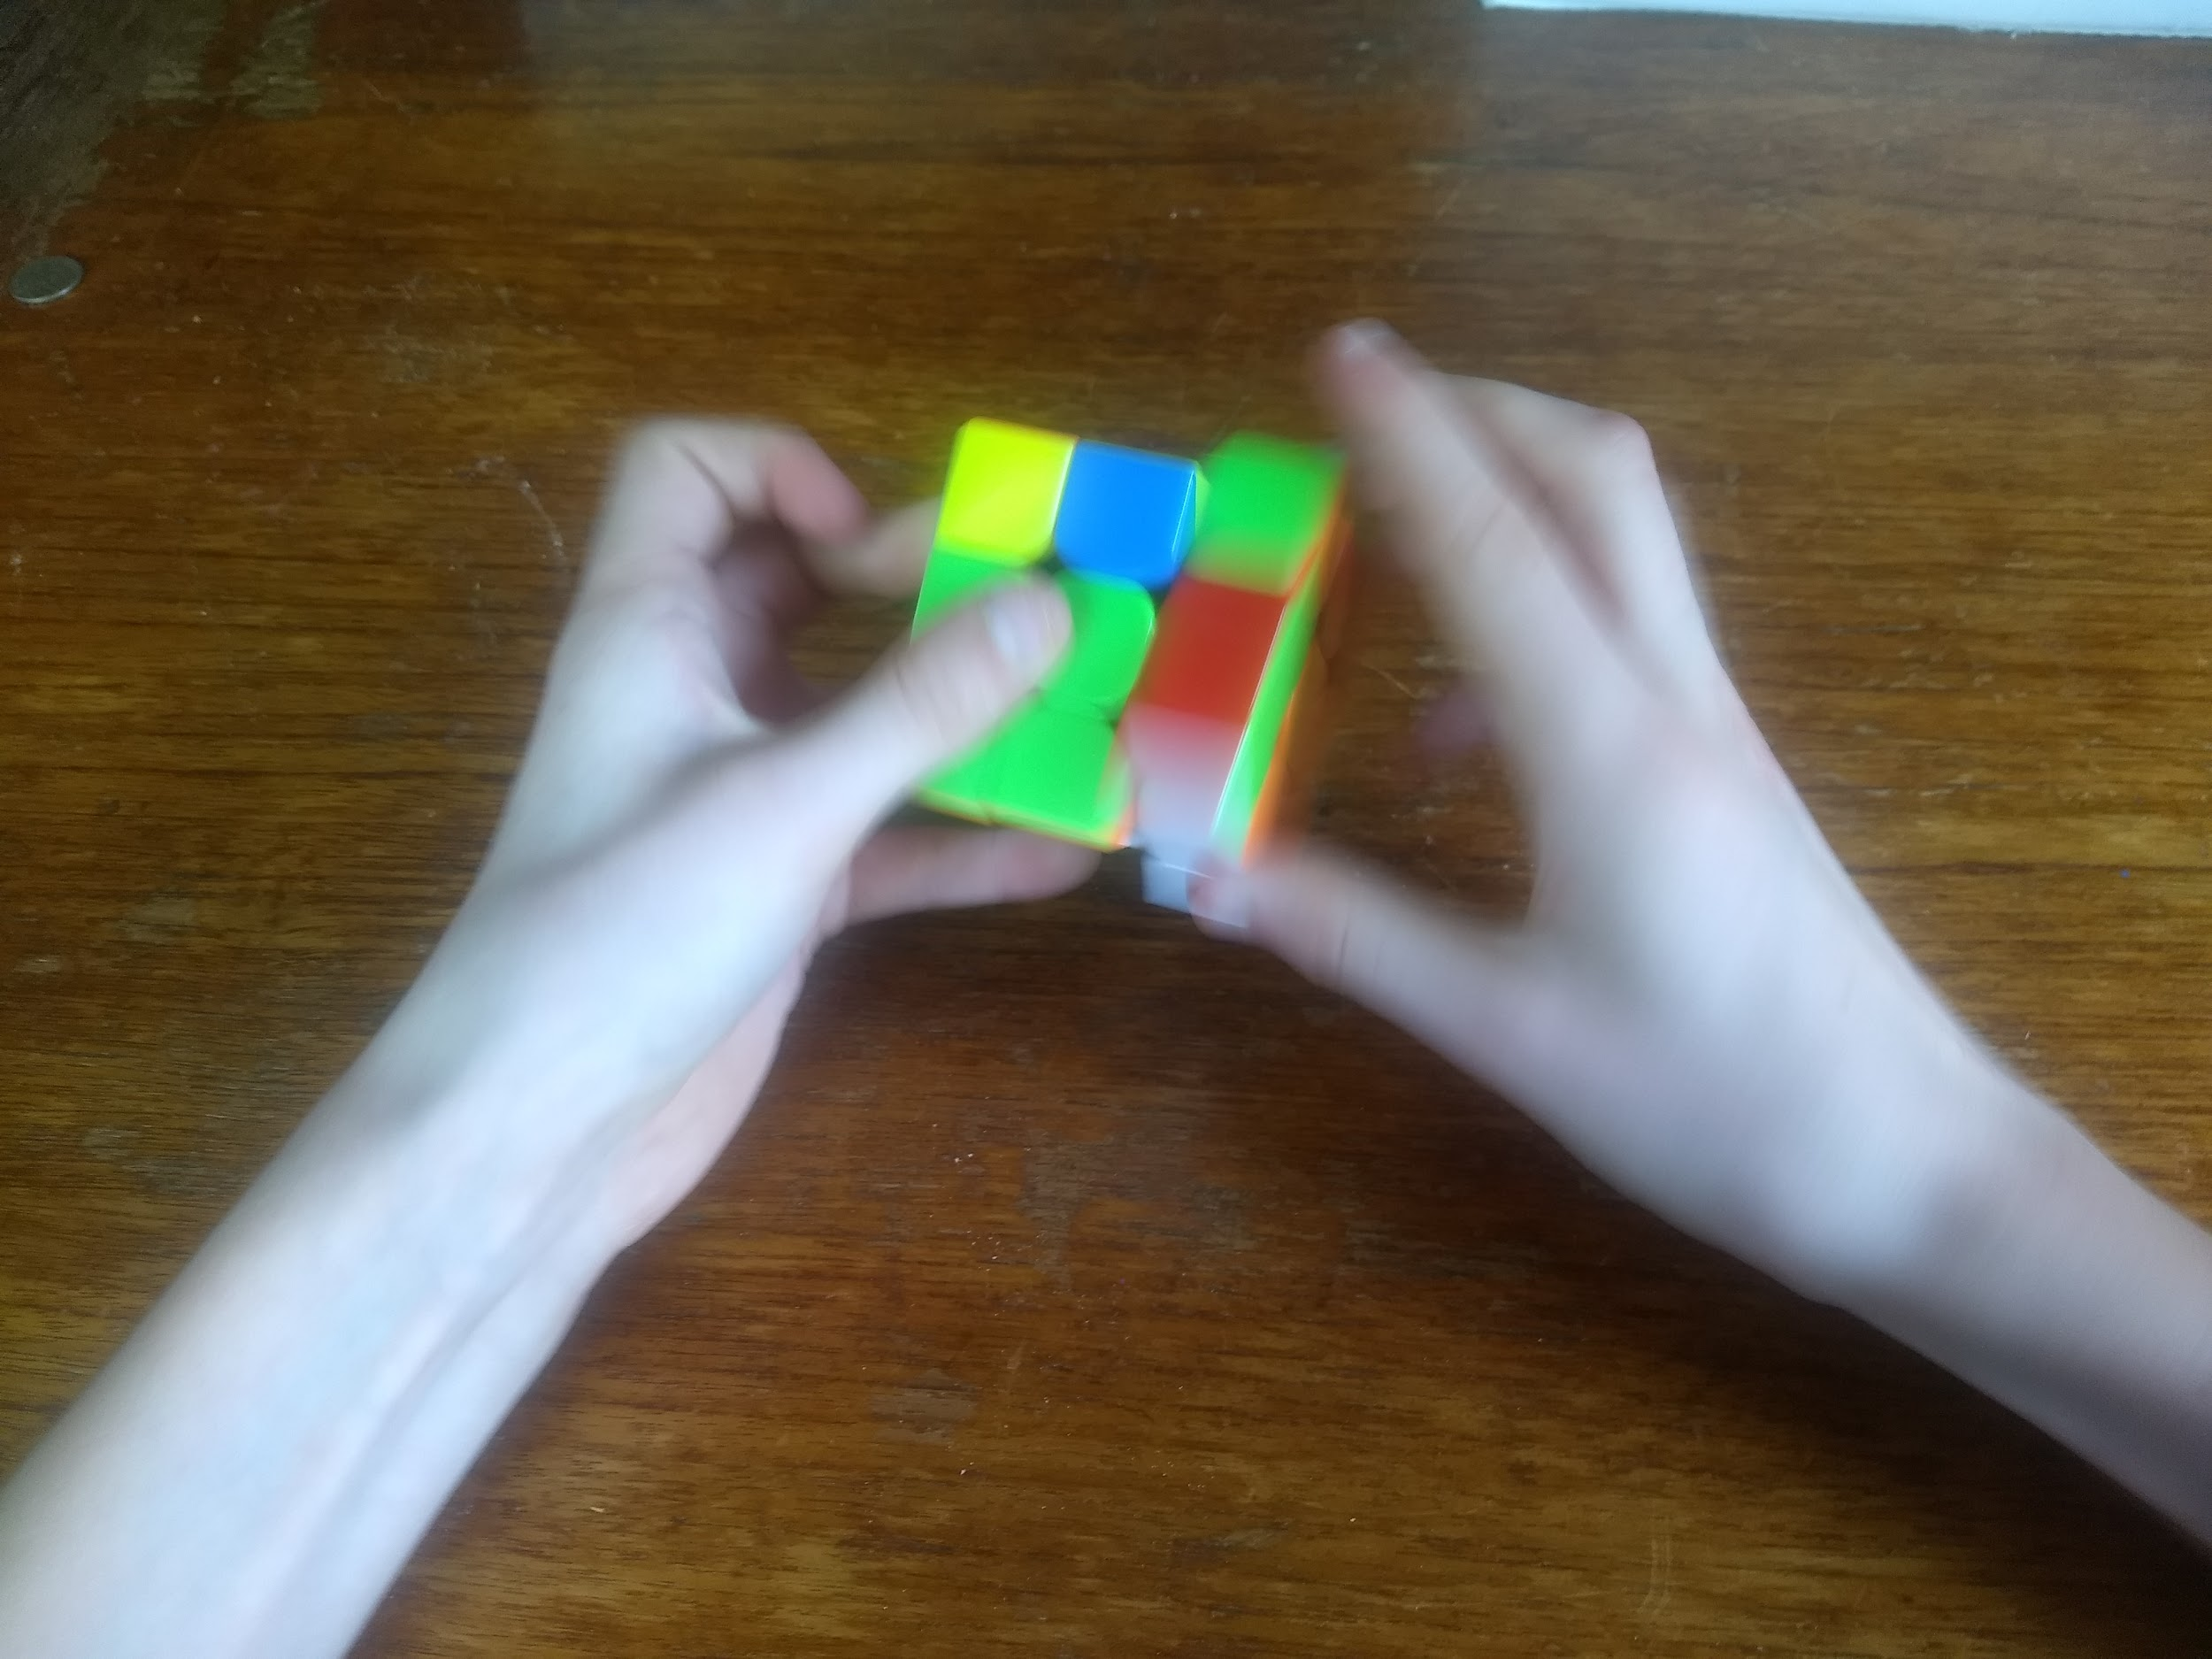
Solve A Rubik’s Cube
A Rubik’s Cube can be quite daunting at first, but once you learn to solve it, it is both easy and satisfying. Turning the cube makes a nice noise, and there’s something about solving something that looks that difficult that’s really nice.

Slide 9
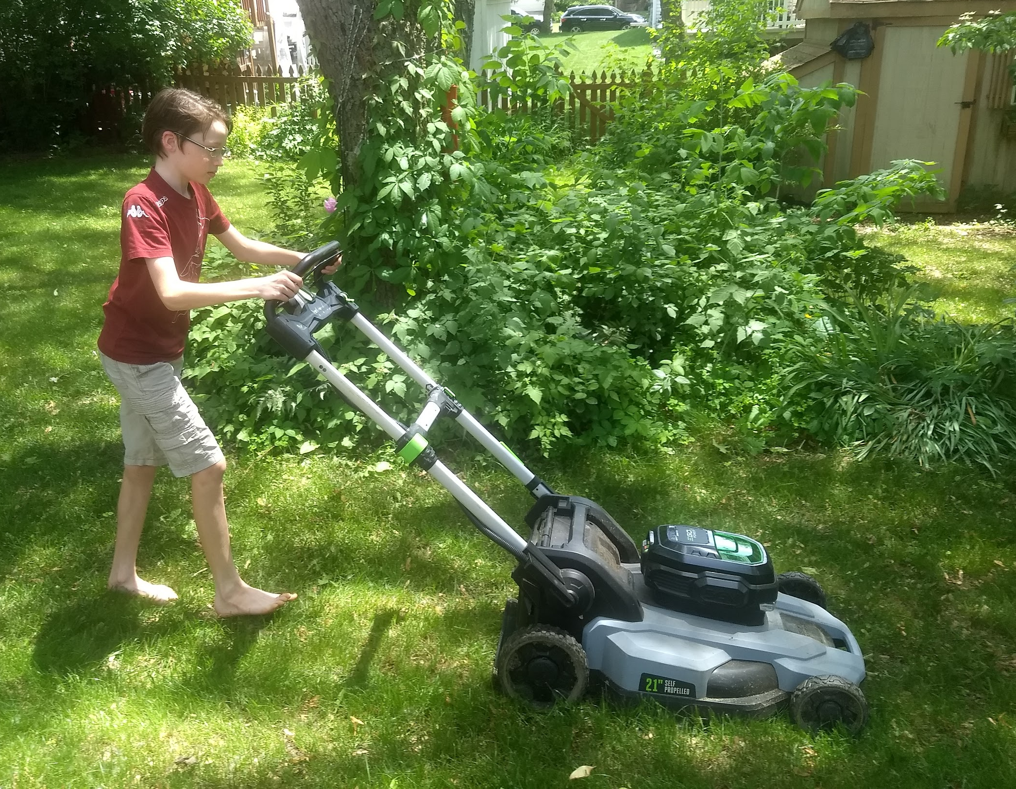
Mow The Lawn
Mowing the lawn might be boring for some, but I really like it. We have an electric self-propelled mower, so it’s nice and quiet. It’s also really fun to mow when the grass is long.

Slide 10
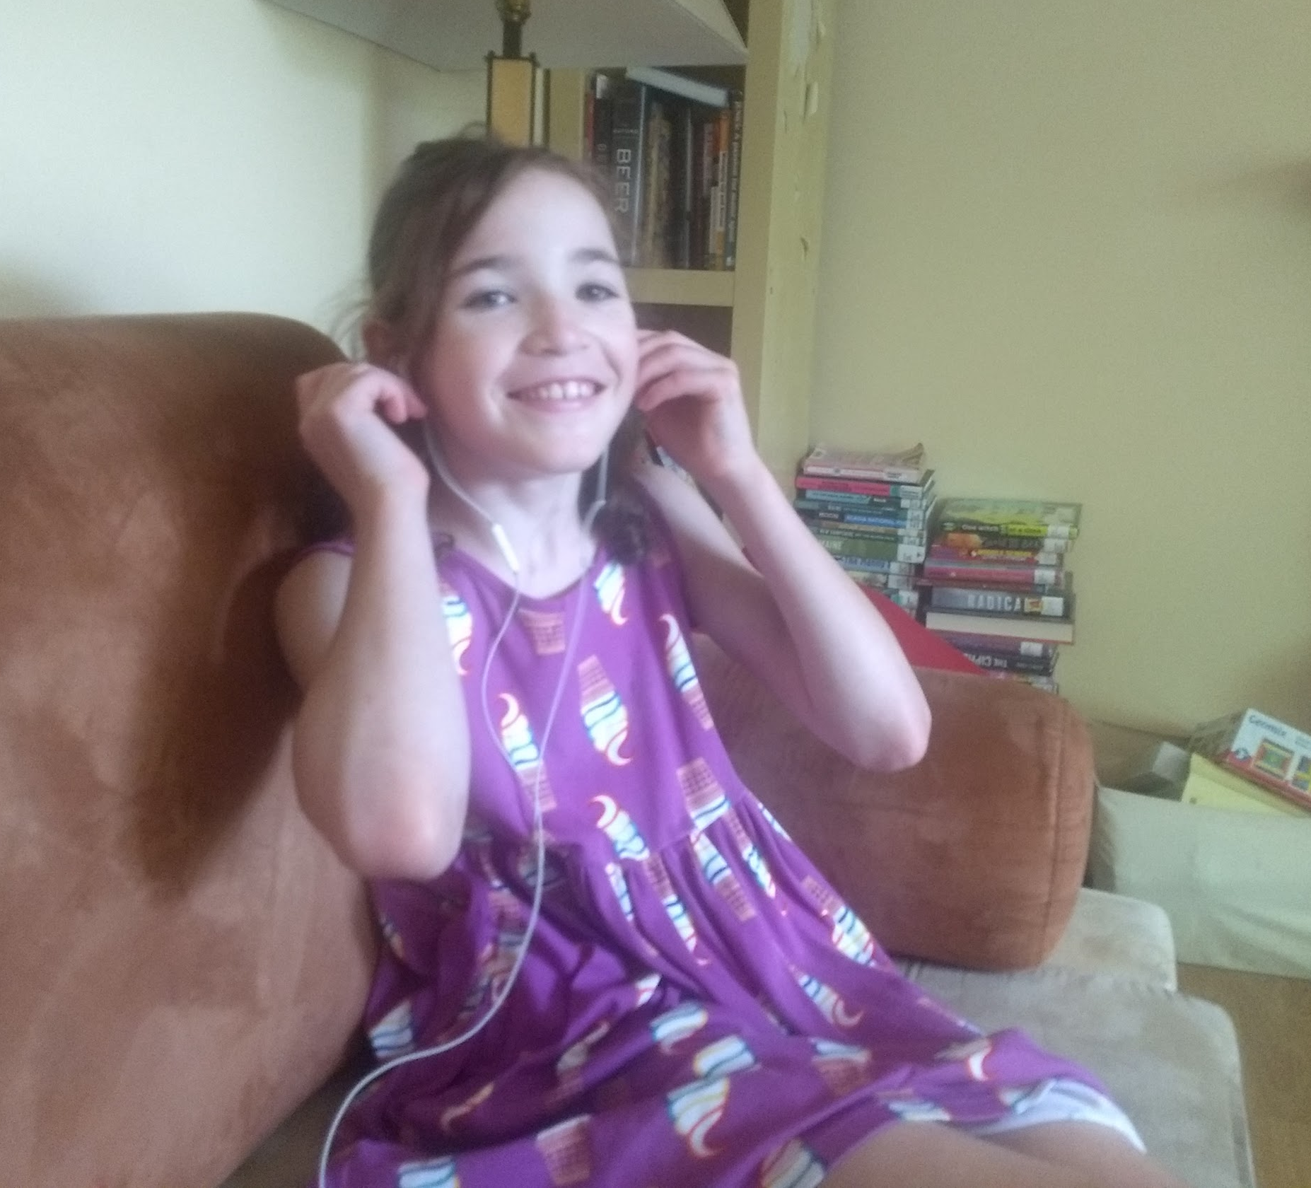
Listen to Music
Listening to music can be a great way to just relax and take a break from everything around you.

Slide 11
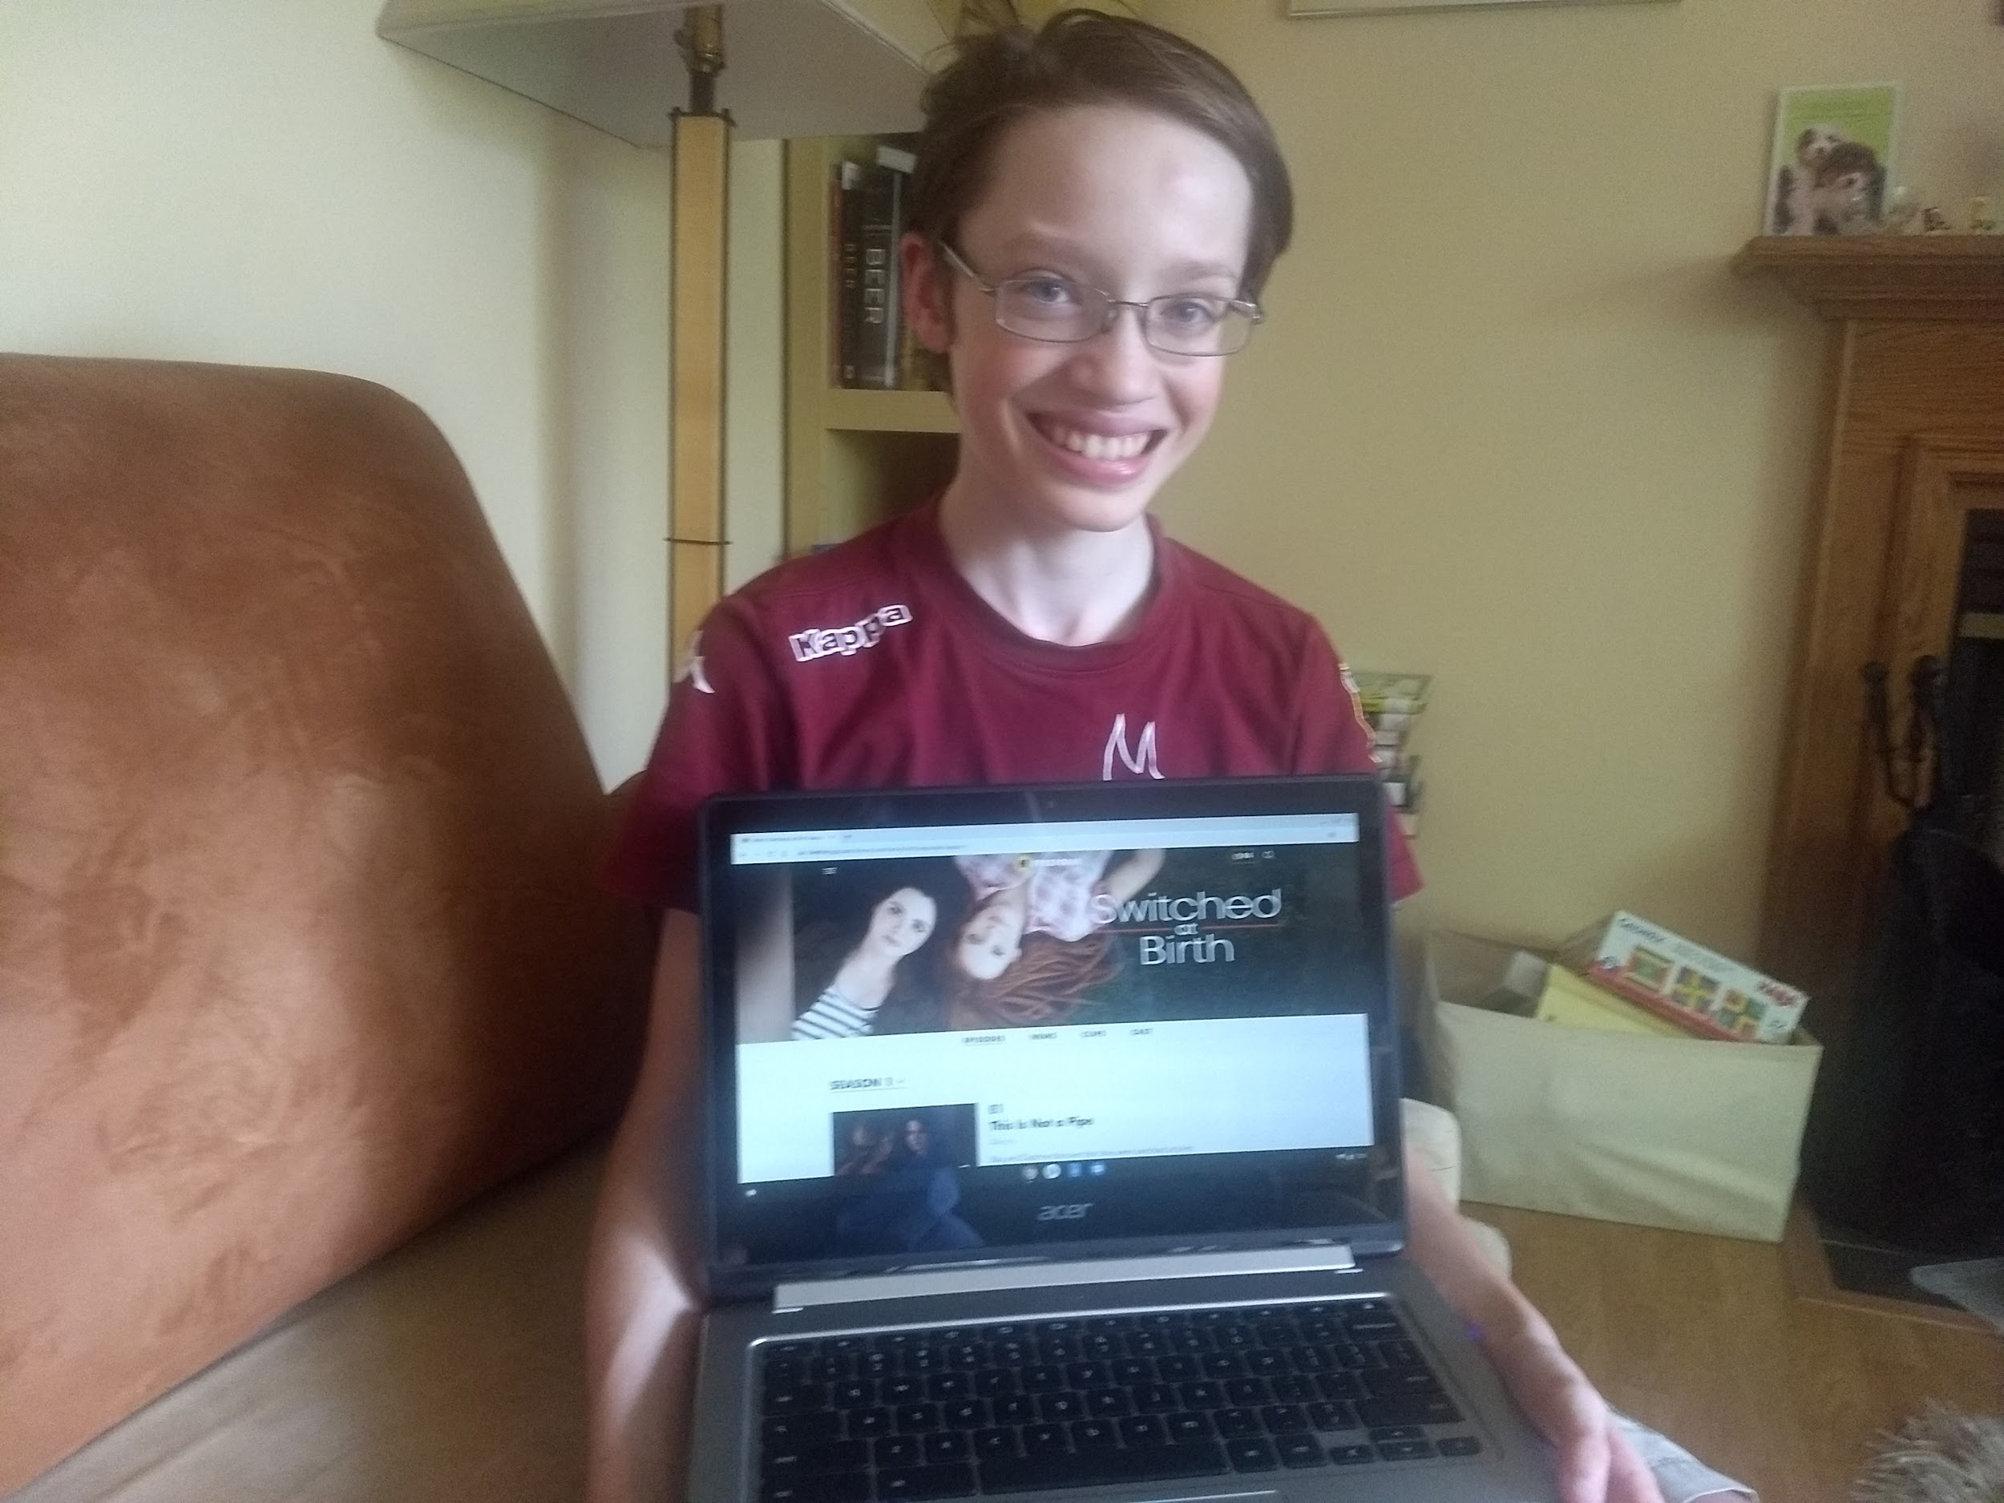
Watching a TV Show
Just like listening to music, watching a TV show is a great way to step out of the world and just take a break. The show I like to watch is called Switched at Birth

Slide 12
The 4HChangemakers is a group of Washtenaw County students (ages 13-18) whose goal is to raise student awareness and help educate their peers about what they can do (for themselves and others) regarding youth mental health in their communities. The students have hosted education/outreach events and trainings.
Teens use digital storytelling to increase awareness and destigmatize mental health through social media and (now virtual) public exhibits. Local and online experts share knowledge of tools to help tell stories: photography, graphic arts, videography, podcasting, interview techniques, meme making, and more. The group continues to explore innovative ways to humanize stories and share information with their peers.
This 4H Changemakers 2020 Digital Exhibit – STOMP OUT STIGMA -
is made possible thanks to generous funding from 4H, Microsoft, and University of Michigan Community Health Services.
Contact Washtenaw County 4H for more information about this and other teen mental health initiatives at (734) 222-3900 https://www.canr.msu.edu/washtenaw/washtenaw_county_4_h/

